Slide 1
CDMA (Code Division Multiple Access)
PRESENTED BY : ANJALI SINGH

Slide 2


Slide 3
Introduction to CDMA
CDMA stands for Code Division Multiple Access.
It is basically a channel access method and is also an example of multiple access.
Multiple access basically means that information by several transmitters can be sent simultaneously onto a single communication channel,optimizing the use of available bandwidth.

Slide 4
Analogy
CDMA simply means communication with different codes.
For example, in a large room with many people, two people can talk privately in English if nobody else understands English. Another two people can talk in Chinese if they are the only ones who understand Chinese, and so on. In other words, the common channel, the space of the room in this case, can easily allow communication between several couples, but in different languages (codes).

Slide 5
Characteristics of CDMA
It allows more users to connect at a given time and thus provides improved data and voice communication capacity.
A full spectrum is used by all the channels in CDMA.
CDMA systems make the use of power control to eliminate the interference and noise and to thus improve the network quality.
CDMA encodes the user transmissions into distinct and unique codes in order to secure its signals.
In CDMA systems all the cells can thus use the same frequency.

Slide 6
Advantages
Increased user capacity is an advantage of the CDMA as it supports a lot more users in comparison to TDMA or FDMA.
CDMA systems have comparatively fewer dropouts than GSM. Thus, it can also be used in rural areas.
The cost of the calls in CDMA is lower in comparison to the cost in GSM.
CDMA provides a high quality of voice with almost no noise during the calls.
Using CDMA problems like multipath and fading do not occur.
CDMA has a very low power requirement

Slide 7
CDMA v/s FDMA v/s TDMA
CDMA differs from FDMA in that only one channel occupies the entire bandwidth of the link.
CDMA differs from TDMA in that all stations can send data simultaneously; there is no timesharing.

Slide 8
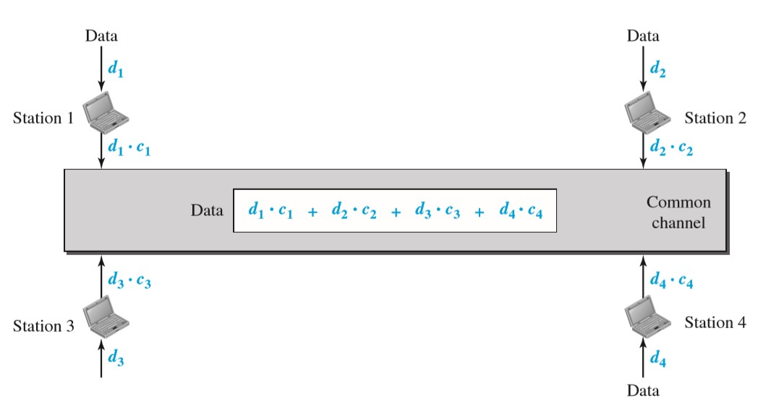
NOTE :- In CDMA, one channel carries all transmissions simultaneously.

Slide 9
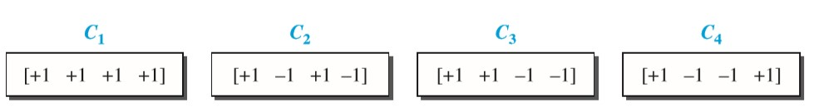
Chips
CDMA is based on coding theory. Each station is assigned a code, which is a sequence of numbers called chips.

Slide 10
Chip Sequence
Each sequence is made of N elements, where N is the number of stations.
If we multiply a sequence by a number, every element in the sequence is multiplied by that element. This is called multiplication of a sequence by a scalar. For example, 2 • [+1 +1 −1 −1] = [+2 +2 −2 −2]

Slide 11
If we multiply two different sequences, element by element, and add the results, we get 0. This is called the inner product of two different sequences. For example, [+1 +1 −1 −1] • [+1 +1 +1 +1] = 1 + 1 − 1 − 1 = 0
If we multiply two equal sequences, element by element, and add the results, we get N, where N is the number of elements in each sequence. This is called the inner product of two equal sequences. For example, [+1 +1 −1 −1] • [+1 +1 −1 −1] = 1 + 1 + 1 + 1 = 4
Adding two sequences means adding the corresponding elements. The result is another sequence. For example, [+1 +1 −1 −1] + [+1 +1 +1 +1] = [+2 +2 0 0]

Slide 12
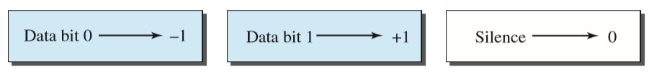
Data Representation
If a station needs to send a 0 bit, it encodes it as − 1.
If it needs to send a 1 bit, it encodes it as +1.
When a station is idle, it sends no signal, which is interpreted as a 0

Slide 13
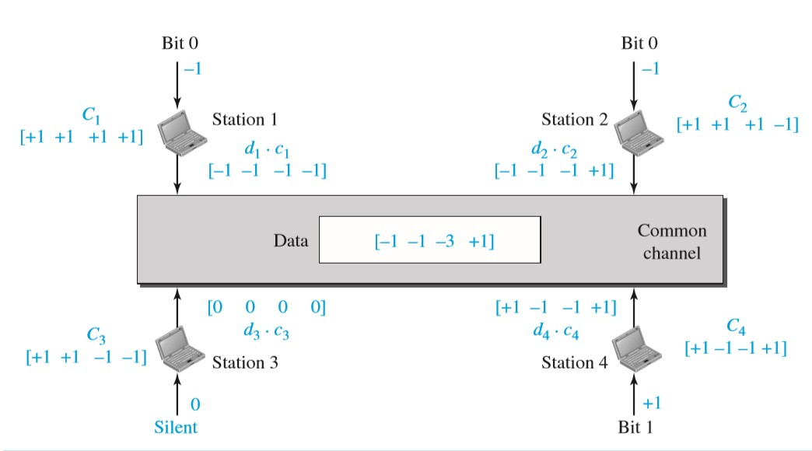
Sharing channel in CDMA

Slide 14
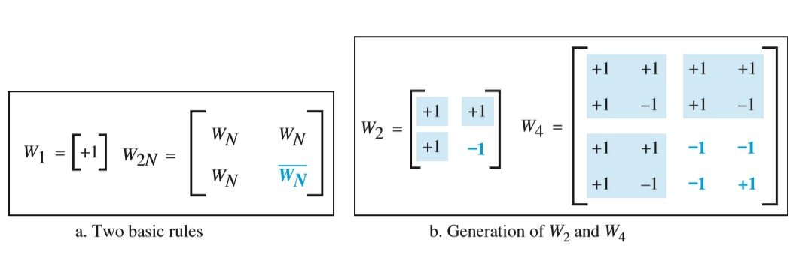
General rule and examples of creating Walsh tables

Slide 15
NOTE :- The number of sequences in a Walsh table needs to be N = 2^{m}.

Slide 16
Example 1
Find the chips for a network with
a. Two stations
b. Four stations
Solution
We can use the rows of W2 and W4
For a two-station network, we have
[+1 +1] and [+1 −1].
b. For a four-station network we have
[+1 +1 +1 +1], [+1 −1 +1 −1], [+1 +1 −1 −1], and [+1 −1 −1 +1].

Slide 17
Example 2
What is the number of sequences if we have 90 stations in our network?
Solution
The number of sequences needs to be 2m. We need to choose m = 7 and N = 27 or 128. We can then use 90 of the sequences as the chips.

Slide 18
Uses of CDMA
It is used in the Global Positioning System (GPS).
It is used by several mobile phone companies (e.g. Qualcomm standard IS-2000 also known as CDMA2000)
W-CDMA is used in UTMS 3G mobile phone standard.
CDMA has been used in OmniTRACS satellite system for transportation

Slide 19
References
-BY McGraw-Hill Forouzan Networking Behrouzan

Slide 20
THANKYOU

